Slide 1
Process Performance Metrics
U4 – Measure
E4 – Process Capability and Performance
The element ‘Process Capability and Performance’ explains process capability and performance in relation to specification limits.
Yellow Belt
Notes:
Welcome to the Process Performance Metrics module

Slide 2
Process Performance Metrics
The importance of metrics
Two important management tasks: sustain and improve
We must make performances measurable so that we can ensure that performance will not deteriorate
We must make performances measurable so that we can make the results of improvement activities visible
Notes:
It is important, for the management of a company, to be able to use clear performance indicators or ‘metrics’. The current performance of the company needs to be recorded, to be able to evaluate the level at which the company is performing. A second goal is to gain insight into improvement projects to discover if they have shown results. Furthermore, well-chosen performance indicators can form a basis for important communication with operators and the company environment concerning performance.

Slide 3
Process Performance Metrics
Lean Six Sigma metrics
Metrics = Performance Indicator
Lean & Six Sigma both have their own performance metrics - each with a different focus:
Lean metrics focus on effectiveness and (delivery) time
Six Sigma metrics focus on quality and capability
Both focus on costs costs (€) and efficiency (%)
Notes:
If we look at the most frequently used performance indicators in Lean and Six Sigma, we can see a difference in focus. In Lean, the emphasis is on effectiveness and delivery time. Here, we act to prevent ‘Muda’ or waste and to reduce non- value added steps in the process. In Six Sigma, we concentrate on controlling the processes within the customer’s specification for the product. In both cases, the resulting reduction of cost and the improvement of efficiency is of importance. COPQ stands for the Cost Of Poor Quality -think of the iceberg with the few visible costs and the many less obvious costs.

Slide 4

Process Performance Metrics
Takt time
Takt time: the average time between two consecutive customer procedures/ processes/ consultations
‘Takt’ is German and means the pace determined by the orchestra’s conductor
The customer’s demand determines the Takt time (not the hospital/ clinic / general practitioner)
Customer
Available production(process) time
Takt time =
Required production (process) volume
Notes:
We will first discuss the Takt time. The word ‘Takt’ is borrowed from the German language and is an indication of the pace that is determined by the conductor of an orchestra. The most important difference between usual production planning and Takt time is that the Takt time is controlled by customer demand. It is the average time between two customer orders. Takt time is calculated by dividing the available production time by the necessary production volume. The pace of production then needs to be adjusted so that every workstation can finish their task within the available Takt time. In this case, the assumption is that the customer demand is relatively stable over time.

Slide 5
Process Performance Metrics
Example Takt time in elderly home
Customer demand: 200 meals to be served at all private rooms between 17.00 and 19.00 every day
Available production (process) time:
2 hours per day
3 delivery employees
Available production(process) time
Takt time =
Required production (process) volume
3 x (2 hours) 360 (minutes/day)
=
(200 meals per 2 hours per day) 200 (meals/ day)
= 1,8 min/meal
Takt time =
Notes:
Here, we will use an example to explain how to calculate Takt time. Assume that the average customer demand per day is 200 meals. The kitchen is operating 2 hours per day with 3 employees.
The takt time is 3 employees X 2 hours /200 meals is 1.8 min/meal.

Slide 6
Process Performance Metrics
Cycle time (C/T) & Lead time (L/T)
Cycle time
The time between the completion of 2 successive procedures/ processes/ tasks by observation
The time it takes personnel to go through all of the work elements before repeating them
Lead time
Time needed for ONE part to pass the complete process/ value stream, from start to finish
Example: a nurse can take a patient for a blood sample in runs over a day every 10 minutes, but the actual (value adding) process (taking the blood) takes only 30 seconds:
Value Added Time = 30 s
NON Value Added Time = 9 min 30 s
Lead Time = 10 minutes
Notes:
The next performance indicator or ‘metric’ that we will look at is the cycle time, which is written as C/T. Cycle time is the necessary time between the completion of 2 successive procedures/processes by observation. The product or the time personnel needs to go through all the work steps one time at the specific station. The cycle time needs to be shorter than the Takt time, otherwise the customer demand cannot be met unless we produce on several machines at the same time.

Slide 7
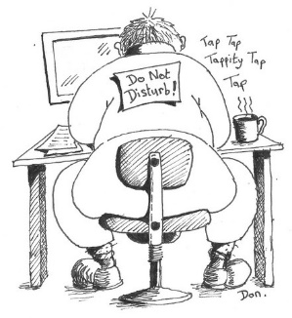

Process Performance Metrics
Cycle time (C/T) & Lead time (L/T)
Cycle time
Customer orders
Product/ service ready
Lead Time
Notes:
The difference in cycle time and the lead time are demonstrated graphically here

Slide 8

Process Performance Metrics
Defects per unit (DPU)
DPU is the number of defects per unit
DPU can be greater than 1 because a unit can have several defects (for instance: a prescription may have more than 1 error
Example
Number of units = 3000 number of written prescriptions
Number of defects = 53 number of wrong or missing dosages
So per prescription received into pharmacy, there are on average 0,02 defects
Notes:
DPU or Defects per Unit is in this case 0.0177 , which is calculated by dividing the 53 wrong dosages by the 3000 number of total prescriptions. Each prescription contains on average 0.0177 defects, but in reality each prescription can only contain zero, one or two defects. Normally, the number of defects per unit is very low, we therefore often use another indicator.

Slide 9

Process Performance Metrics
Defects per million opportunities (DPMO)
Opportunities = 2 possible defects per unit: missing & wrong
Number of units = 3000 number of prescriptions issued
Number of defects = 53 number of missing and wrong dosages
In other words: if we write 500.000 prescriptions, we can expect that there will be 8.833 defects (missing and wrong dosages)
Notes:
Instead of the DPU, we use the number of defects per million opportunities or DPMO. If we inspect a prescription for missing or wrong dosages, we have two potential opportunities for defects. We will use the same figures as in the previous example, in which we inspected 3000 prescriptions and found 53 defects.

Slide 10
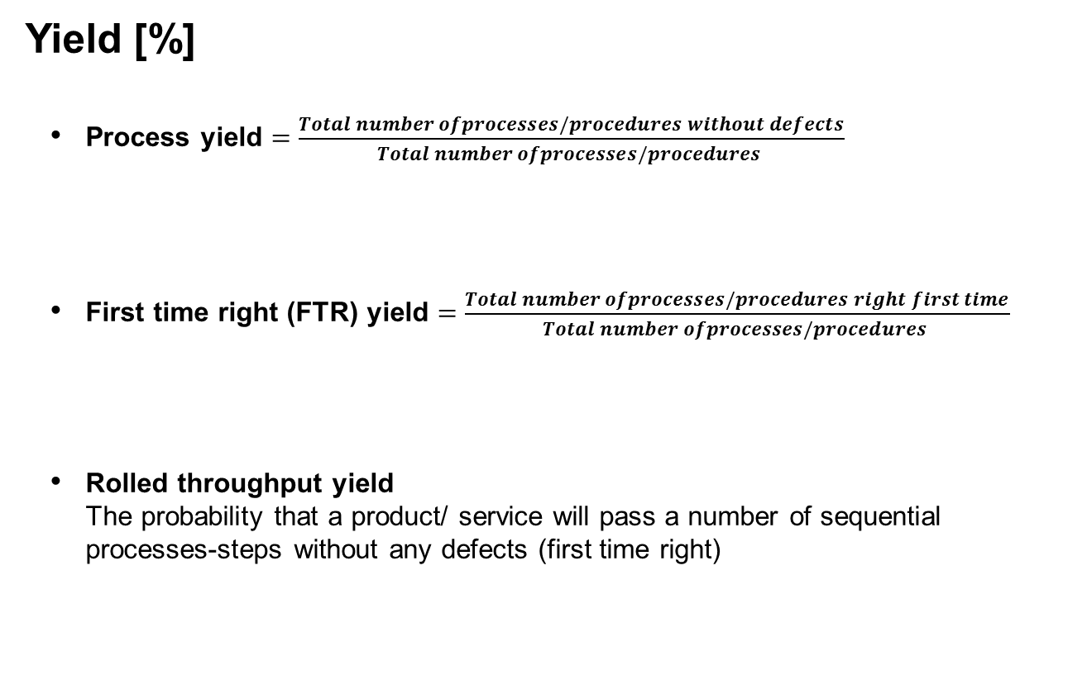
Process Performance Metrics
Yield [%]
Process yield $=\frac{Total number ofprocesses/procedures without defects}{Total number ofprocesses/procedures }$
First time right (FTR) yield $=\frac{Total number ofprocesses/procedures right first time}{Total number ofprocesses/procedures }$
Rolled throughput yield The probability that a product/ service will pass a number of sequential processes-steps without any defects (first time right)
Notes:
The DPMO or the number of Defects per million opportunities is calculated by one million times 53 defects divided by two opportunities times 30 defects. The result is 833,000 defects. In other words, we can expect to find 833,000 defects in only 500,000 prescriptions that we inspect.

Slide 11
Process Performance Metrics
Example Process yield
Process of testing bloodsamples in a local laboratory. When patients visit a general practioner sometimes a blood sample is taken. This blood sample is sent to the local laboratory to be analysed.
Process A Prepare sample
Process B Measure sample
Process C Analyse sample
Process D Report sample
Notes:
In this production process, we will calculate the ‘First Time Yield’ or ‘Process Yield’ of these 4 process steps in a blood sampling laboratory. For each step, the number of products/blood samples going in and out are known. Products going to the next step are without any defects.

Slide 12
Process Performance Metrics
Process yield
Process yield =
Process | Scrap | Out | Process yield
A | 10 | 90 | 90 / (90+10) | = 90 /100 | = 90%
B | 10 | 80 | 80 / (80+10) | = 80 / 90 | = 89%
C | 5 | 75 | 75 / (75+5) | = 75 / 80 | = 94%
D | 5 | 70 | 70 / (70+5) | = 70 / 75 | = 93%
0.90 x 0.89 x 0.94 x 0.93 = 70%
C
D
Notes:
We can see that the yield per process step varies between 89% and 94%, but that after 4 steps, the total process yield is only 70%. Also, no rework has been performed during any of the steps within this process.

Slide 13
Process Performance Metrics
Example Rolled throughput yield
In the local laboratory some samples have to be reworked
Process A : 100 blood samples in; 10 scrapped + 5 reworked; 90 out
Process B : 90 blood samples in; 10 scrapped + 7 reworked; 80 out
Process C : 80 blood samples in; 5 scrapped + 3 reworked; 75 out
Process D : 75 blood samples in; 5 scrapped + 5 reworked; 70 out
A
90
B
80
C
75
D
70
5
7
3
5
10
10
5
5
Notes:
In a different process, rework is performed to reduce the losses per step. There are also 4 steps in the process that are working sequentially and in the end, 70 units leave production.

Slide 14
Process Performance Metrics
First time right yield and Rolled troughput yield
Rolled throughput yield =
Process | Scrap | Rework | Out | First time right yield
A | 10 | 5 | 90 | (90-5) / (90+10) | = 85 /100 | = 85%
B | 10 | 7 | 80 | (80-7) / (80+10) | = 73 / 90 | = 81%
C | 5 | 3 | 75 | (75-3) / (75+5) | = 72 / 80 | = 90%
D | 5 | 5 | 70 | (70-5) / (70+5) | = 65 / 75 | = 87%
0.85 x 0.81 x 0.90 x 0.87 = 54%
À
Notes:
If we look at the ‘First Time Yield’ per process step, we see that it varies between 81 and 90%. This doesn’t seem very dramatic, but the ‘Rolled Throughput Yield’ here is only 54%. This means that only 54% of all units leave the factory directly ‘good’, meaning without any rework. The more process steps you need to finish the product, the higher the risk of a low overall efficiency.
------------

Slide 15
Process Performance Metrics
Summary Yield
Proces | Units out | Scrap | Rework |  | Process Yield | Total Process Yield |  | First Time Right Yield | Rolled Throughput Yield
A | 90 | 10 | 5 |  | 90% | 90% |  | 85% | 85%
B | 80 | 10 | 7 |  | 89% | 80% |  | 81% | 69%
C | 75 | 5 | 3 |  | 94% | 75% |  | 90% | 62%
D | 70 | 5 | 5 |  | 93% | 70% |  | 87% | 54%
‘Hidden factory’
Notes:
In summary the different methods for calculating yield can help you identify the hidden waste or hidden factory within your process.

Slide 16
Process Capability & Performance
U4 – Measure
E4 – Process Capability and Performance
The element ‘Process Capability and Performance’ explains process capability and performance in relation to specification limits.
Yellow Belt
Notes:
Welcome to the Process Capability & Performance module

Slide 17
Process Capability & Performance
Definition of process capability:
‘The ability of a process to supply products/ services that satisfy customer expectations / specifications’
Example Elderly home centre
The specifications of the ideal temperature of a meal in an Elderly home centre are: between 60 and 70 degrees
A capability analysis indicates how capable the process is to meet specifications and how the process can be improved and secured
In order to reliably determine the process capability, the process must be stable
An unstable process is unpredictable
Notes:
In an ideal world, we would be able to supply our customer with exactly what he needed at the precise moment he needed it. In reality however, we must look at the ability of our process to deliver the products that meet the specification of the customer. If we want to draw a conclusion about capability based on statistical information, the process needs to be stable. This means that we cannot discuss a process that shows regular ‘out-of-control’ situations. Alternatively, if we study a stable process, we can form an opinion about the degree to which the process is able to meet the customer specification. We can also see if a process can be improved, for instance by centering a process relative to the specification limits.

Slide 18

Process Capability & Performance
Example Temperature problems
As a result of a survey on the meal service of an Elderly home centre the temperature of the meal was found to be an issue with clients. E.g. too hot or too cold
Interviews learned that the ideal temp was between 60 and 70ºC
Lower specification limit
(LSL)
Upper specification limit
(USL)
60
70
Notes:
A meal service in an elderly care home was surveyed and meals found to be either too hot or too cold. The ideal temperature has a lower specification of 60 and a higher specification of 70.

Slide 19
Process Capability & Performance
Example Temperature problems
The Elderly home centre started to measure the temperature of the meals
The average temperature was 65ºC
The standard deviation was 10ºC
(LSL)
Average
(USL)
60
65
70
Notes:
When the elderly home centre started to measure the temperature of the meals the average temp was 65 degrees Celsius and the standard deviation was 10 degrees Celsius.

Slide 20
Process Capability & Performance
Example Temperature problems
Based on the information collected we can see that approx. 30% of the meals served is either too hot or too cold
(LSL)
(USL)
60
70
Notes:
From the information gathered it can be seen that approx. 30% of the meals are either too hot or too cold (outside of the spec limits)

Slide 21
Process Capability & Performance
Example Temperature problems
So, in order to meet clients expectations, they had to improve the process by reducing the variation in the meal temperature
(LSL)
(USL)
60
70
Notes:
The process needs to be improved to better meet the customers expectations.

Slide 22
Process Capability & Performance
Example Temperature problems
Sometimes it’s not (only) the variation, but (also) the average that needs adjusting
(LSL)
(USL)
60
70
Notes:
Sometimes not only the variation but also the average needs adjusting.

Slide 23
Process Capability & Performance
Capability vs. Performance
Process capability: The potential capability of the process
(Cp and Cpk)
Process performance: The processes overall performance
(Pp and Ppk)
What the process can do (Cp) and what the process does (Ppk)
Notes:
If we want to express capability as a statistical value, we use Cp for the short term. The definition is shown in the formula. We divide the range of the specification (or the difference between upper and lower limit) by 6 times the variation of the process which is expressed as standard deviation ‘within’. The Cp assumes that the process could be completely centred and describes how good we could potentially be.
In practice, the process will not always be on target so we will use the Cpk of the process. The Cpk is the capability expressed in relation to the closest specification limit. Because we only look at one specification limit, we don’t divide by 6 times the variation, but by 3 times the variation, expressed as the standard deviation ‘within’. Because we use the minimum of the CpL and CpU, the Cpk will always be lower than the Cp. Only with a perfectly centered process will the Cpk be the same as the Cp.

Slide 24
Process Capability & Performance
Short term vs. long term capability
Short term
Capability
Temperature of hot meal measured per day
Long term
Performance
Temperature of hot meal measured per week
Notes:
If we were to study our process over a longer period of time, we would see an increase in variation. The average of the process could shift as much as 1.5 sigma, but this is an assumption. We use the term ‘capability’ when we are discussing short term effects and the term ‘performance’ when we are talking about long term effects.

